Slide 1
Boosting Algorithm

Slide 2
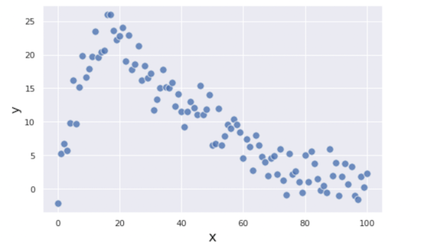
Usage:
To solve complex problems and datasets

Slide 3
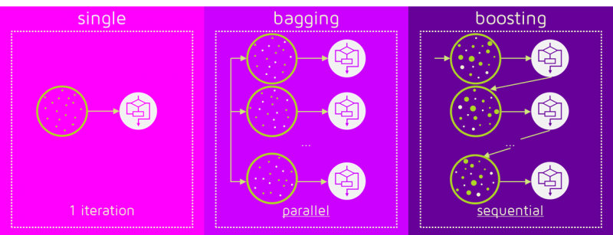
Difference between Bagging and Boosting:

Slide 4
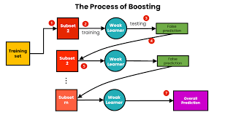
Working process of boosting Algorithm:

Slide 5
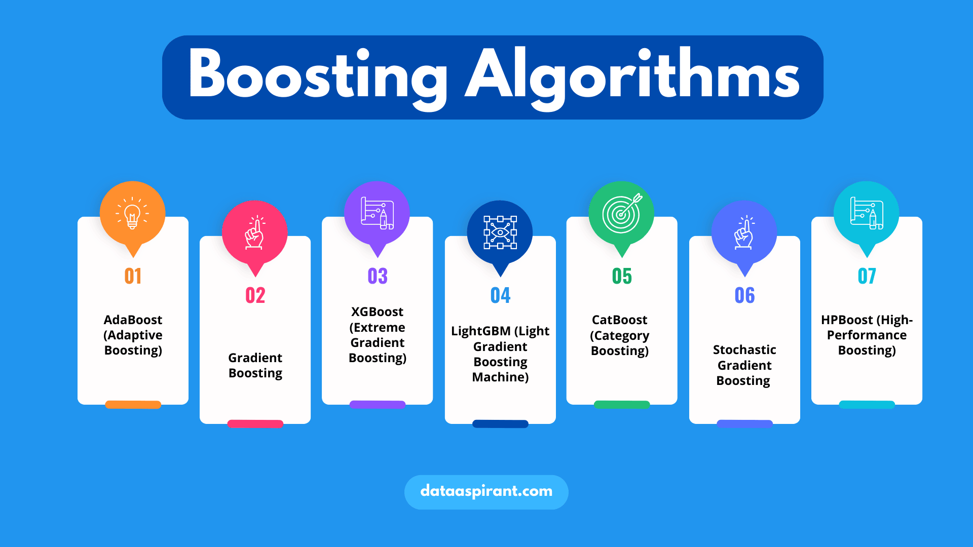
Types of Boosting Algorithm:

